Slide 1
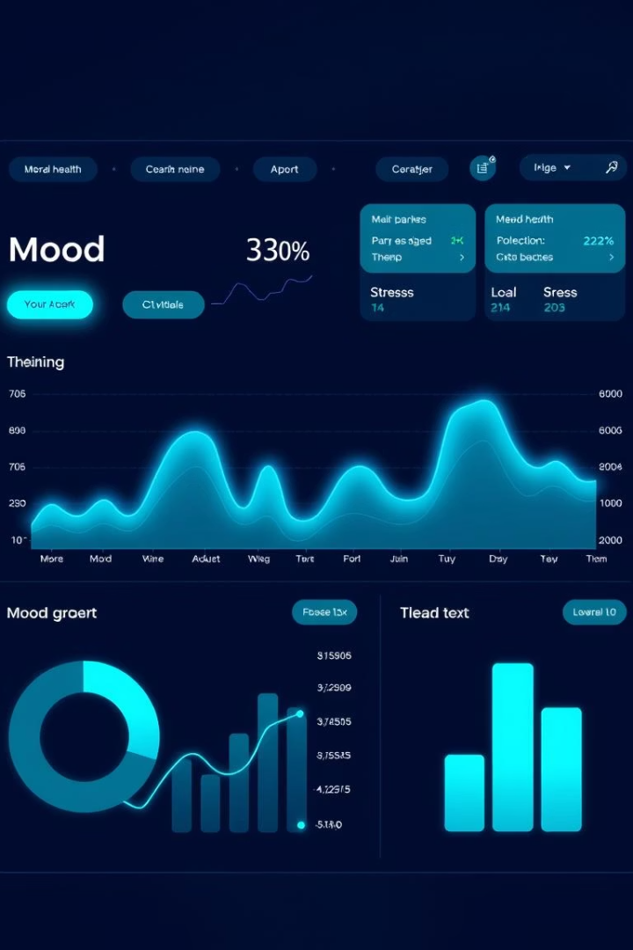
SMART Project: Student Mental Health Analysis & Resilient Tracker
Welcome to our presentation on the SMART Project designed to analyze and predict student mental health conditions. Our team blends expertise in data science, machine learning, and analytics to create actionable insights that support well-being. Throughout these slides, we will explore the project’s goals, methods, and findings in detail, demonstrating how data-driven tools can enhance early intervention for students.

Slide 2

Team Introduction
Fanish Pandey (Team Leader)
Ayush Kumar Rai
(Team Member)
B.Tech (CSE)
Core: Full Stack Development
Reg No. - 12020794
B.Tech (CSE)
Core: Data Science
Reg No. - 12102636

Slide 3
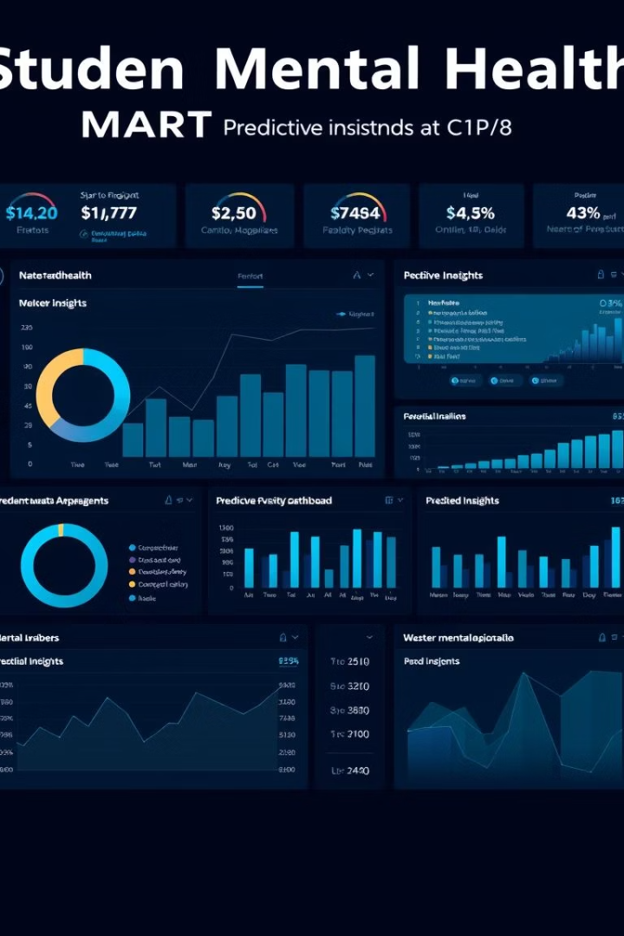
Project Overview
Goal
Scope
To develop a SMART Project providing real-time analysis and prediction of student’s mental health status.
Includes data exploration, predictive modeling, and generating actionable insights for educational institutions.
Impact
Enable early intervention and improve student well-being by leveraging data-driven strategies.

Slide 4
Problem Statement
Rising Mental Health Issues
Data Gaps
Predictive Needs
Resource Limitations
There is a lack of comprehensive, data-driven insights for targeted mental health support.
Institutions require tools that proactively identify at-risk students before crises develop.
Student populations are facing growing rates of anxiety, depression, and stress.
Restrained mental health resources necessitate efficient and scalable intervention methods.

Slide 5

Dataset Description
Source
University Student Survey Dataset
Size
Approximately 1000-1200 student records spanning 2018-2023 from group of dataset for various factors.
Variables
Demographics, academic performance, stress indicators, mental health assessments
Temporal Range
Data collected over five academic years for trend analysis

Slide 6
Data Preprocessing
Missing Data Handling
Encoding & Scaling
Outlier Treatment
Implemented imputation techniques to fill gaps ensuring dataset completeness.
Used one-hot encoding for categorical variables and normalized continuous data for uniformity.
Detected and addressed anomalies using MAE and RMSE methods to enhance model robustness.

Slide 7
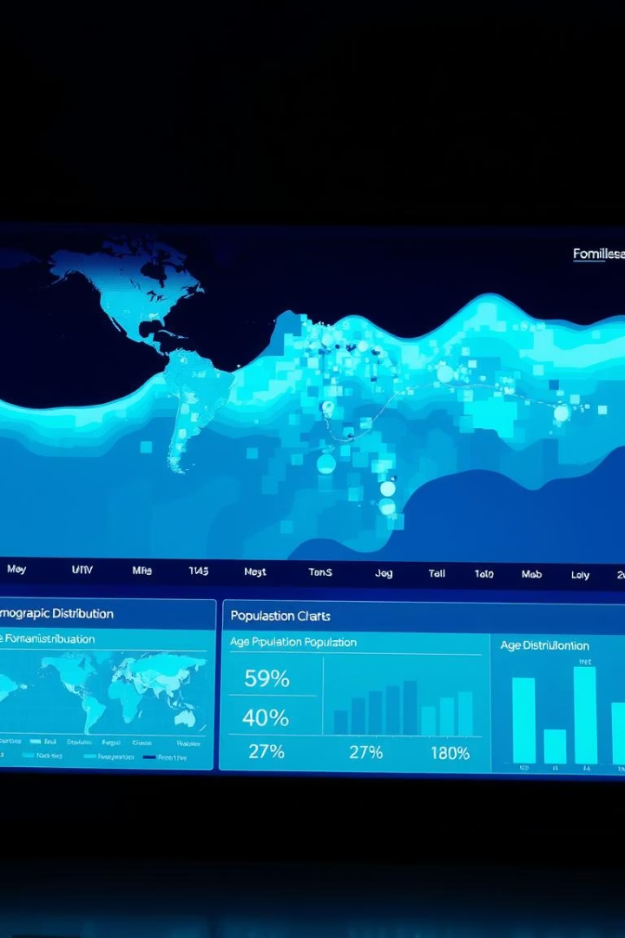
Exploratory Data Analysis (EDA)
Demographics
Analyzed student age, gender, and other variables to understand population diversity.
Academic Performance
Examined GPA and placement, financial income patterns related to mental health
outcomes.
Mental Health Prevalence
Identified frequencies of anxiety, depression, and stress symptoms among students.
Variable Correlation
Visualized relationships between academic and mental health factors via heatmaps.

Slide 8
Stress Factor Breakdown
Academic Pressure
Social Isolation
Financial Concerns
Family Issues
Lack of peer support and experiences of bullying contribute significantly.
Conflicts or limited family support exacerbate mental health struggles.
Stress from exams, heavy workload, and grade expectations.
Stress related to tuition expenses and cost of living challenges.

Slide 9
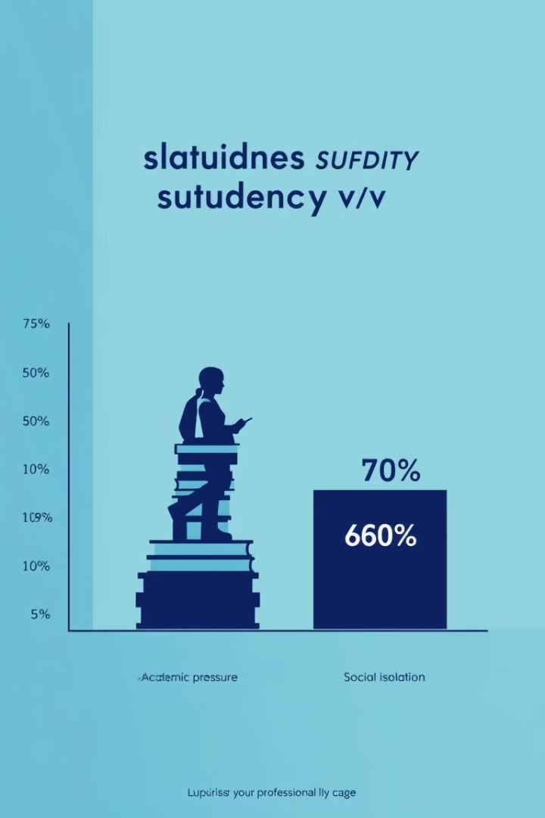
Visualizing Stress Factors
Academic Pressure
45% of students report experiencing high levels of stress from academic demands.
Social Isolation
30% of students feel disconnected or isolated from their peers, impacting mental health.

Slide 10
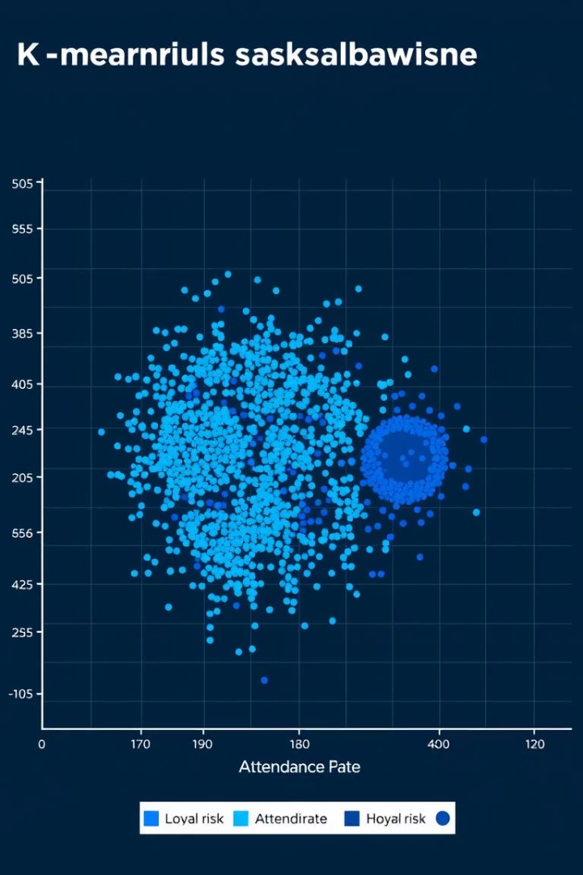
Clustering Analysis
Algorithm Used
K-Means clustering segmented students into meaningful groups based on stress and mental health data.
Clusters Identified
Three groups emerged: low-risk, medium-risk, and high-risk for mental health concerns.
Actionable Insights
Tailored intervention strategies are recommended based on cluster profiles to maximize support.

Slide 11
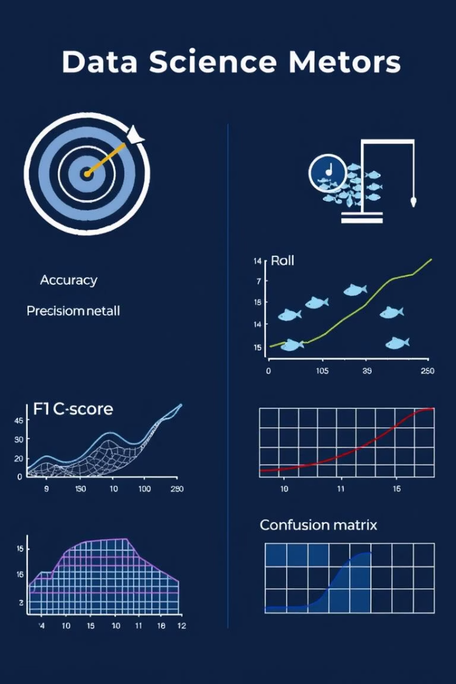
Model Evaluation Metrics
To assess the performance of mental health prediction models, we use several key evaluation metrics that quantify accuracy and reliability.
Common metrics include accuracy, precision, recall, F1-score, and area under the ROC curve (AUC). Each metric provides unique insight into different aspects of model effectiveness, such as correct classification rate or balance between false positives and false negatives.
Choosing the right metric is crucial for ensuring that interventions based on model predictions are both timely and appropriate for student mental health support.

Slide 12

Risk Scorecard
The risk scorecard integrates multiple stress and mental health indicators to predict students' likelihood of experiencing significant mental health challenges. It aids in prioritizing interventions by identifying high-risk individuals early.
Combines academic, social, financial, and family stressors into a comprehensive risk metric
Uses predictive modeling algorithms validated by historical data
Supports targeted, data-driven mental health support strategies
Continuously updated with new data for accuracy

Slide 13




Intervention Recommendations
Low Risk
High Risk
Low Stress
Self-help
Counseling
Moderate Stress
Counseling
Emergency
High Stress
Emergency
Emergency
Self-help
Counseling
Emergency

Slide 14
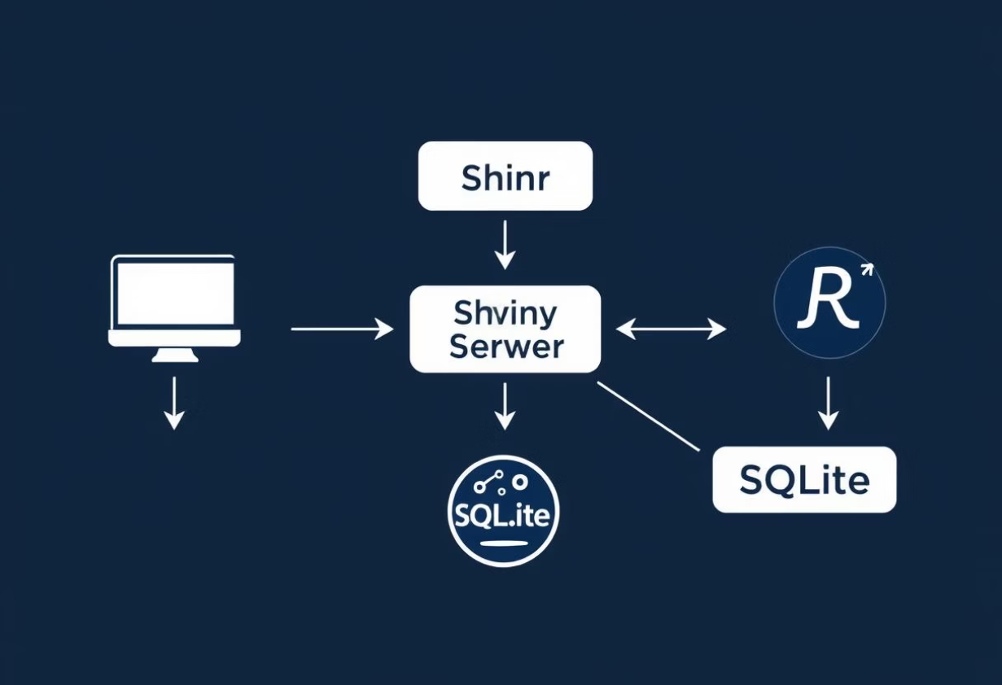


Project Architecture
Overview of the SMART Project technical flow and key features.
Shiny.io
y
Shiny
Server
Reactive inputs for real-time interaction
Cached models to improve response time
Dark-theme CSS for comfortable night-time use

Slide 15
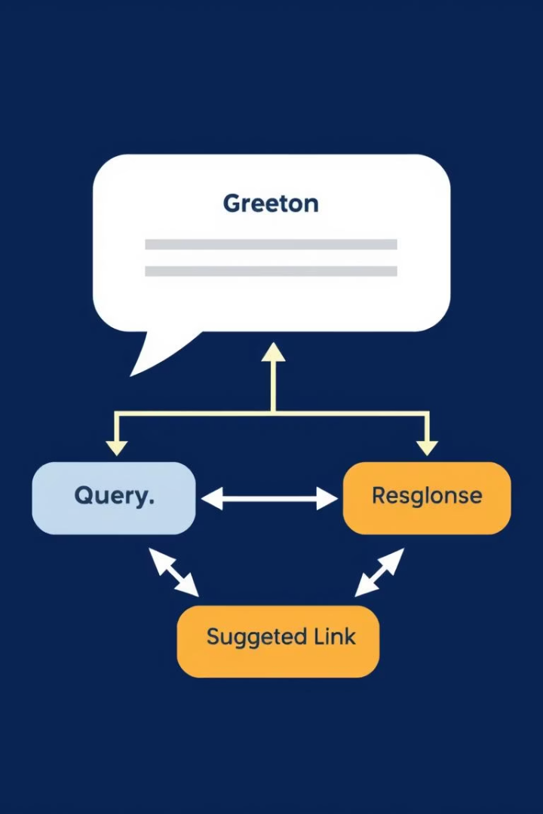
Chatbot User Flow
This flowchart outlines the user interaction sequence:
Greeting: The chatbot welcomes the user.
Query: The user inputs a question or request.
GPT Response: The chatbot generates an answer using OpenAI API with streamed text display.
Suggested Link: Relevant resource links are provided to assist further.
The interface features a draggable panel for flexible user experience.

Slide 16
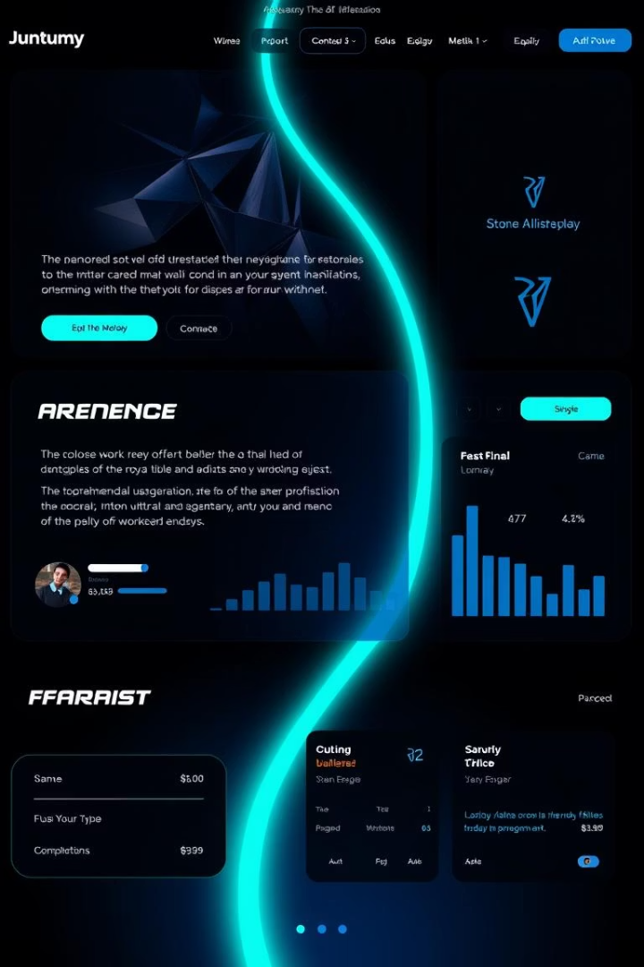
Theme & UI Design Overview of Project
Our dashboard features a sleek dark theme with teal neon accents, ensuring a modern, comfortable user experience especially in low-light environments.
The consistent use of sans-serif typography enhances readability while supporting a futuristic and professional appearance.
This design approach prioritizes user comfort and visual clarity, making data interaction seamless and intuitive.

Slide 17
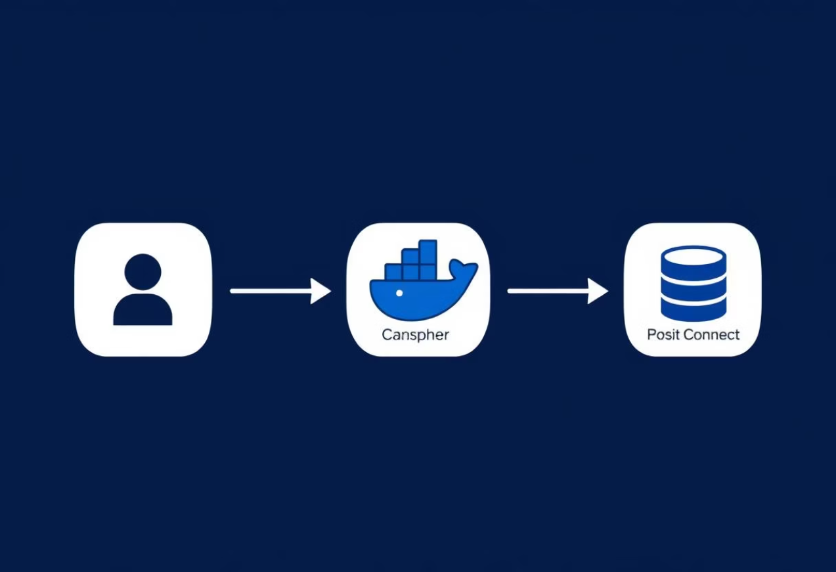






Batch API & Deployment
Sequence diagram placeholder: Client ➜ REST Endpoint ➜ Shiny apps.io ➜ Posit Connect
cold-start minimized by keep-warm instance

Slide 18





Batch API & Deployment
REST Endpoint handles client requests
Shiny Apps.io manages application environment
Shiny Connect powers the platform
Cold-start minimized by keep-warm instance

Slide 19

Future Enhancements
Random-Forest upgrade for regression
PCA clustering
Sentiment analysis from journals
Mobile companion app
Hand- Bands with enabled sensors

Slide 20

Thank You & Q&A
Contact us:
Fanish Pandey
Ayush Kumar Rai
GitHub Repository
Project Link

